Slide 1


<Name>
<Date>

Slide 2

Outline
Executive Summary
Introduction
Methodology
Results
Conclusion
Appendix

Slide 3
Executive Summary
Summary of methodologies
Data collection by web scraping via API or webscraping.
Data wrangling and data cleaning.
Exploratory Data analysis using SQL and Python libraries.
Data Analytics by Folium and Dash
Predictive Analytics via Regression, Classification, Clustering.
Summary of all results
We got to derive conclusive results from the Analytics tools.

Slide 4
Introduction
This Applied data science Capstone project for Space X Falcon 9 rockets aims to predict the successful outcomes of the rocket launches for the first stage using classification models.
The project aims to predict the reusability of the first stage of the rocket which would enable us to derive the cost of the launch.
Space X is a organization which deals in sending rockets to outer space for space exploration purpose.

Slide 5

Section 1

Slide 6
Methodology
Executive Summary
Data collection methodology:
Describes how data was collected using Space X API and web scraping from Wikipedia website
Perform data wrangling
Describes how the data was processed by finding and replacing missing values and also converting columns with categorical values to numerical
Perform exploratory data analysis (EDA) using Matplotlib visualization and SQL
Perform interactive visual analytics using Folium and Plotly Dash
Perform predictive analysis using classification models
How to build, tune, evaluate classification models

Slide 7
Data Collection
he flow chart in Figure 1 shows the data collection process using Python’s library requests and Space X API.
The final data frame is saved as a CSV file using df.to_csv()
The URL below is the GIT repository containing the Jupyter notebook
https://github.com/tridib87/python-capstone-project

Slide 8
Data Collection – SpaceX API
The flow chart in Figure 1 shows the data collection process using Python’s library requests and Space X API.
The final data frame is saved as a CSV file using df.to_csv()
https://github.com/tridib87/python-capstone-project
Place your flowchart of SpaceX API calls here

Slide 9
Data Collection - Scraping
The flow chart in Figure 2 shows the data collection process using Python’s library requests and Beautiful Soup
The final data frame is saved as a CSV file using data_falcon9.to_csv()
The URL below is the GIT repository containing the Jupyter notebook
Add the GitHub URL of the completed web scraping notebook, as an external reference and peer-review purpose
Place your flowchart of web scraping here

Slide 10
Data Wrangling
The following stage involves conducting some Exploratory Data Analysis on the data
Also, converting the outcomes/class into training labels with 1 meaning successful landed and 0 meaning failure to land.
https://github.com/tridib87/python-capstone-project

Slide 11
EDA with Data Visualization
In the exploratory data analysis using data visualization, we use scatter plots to visualize the relationship vis a vis Payload mass vs flight number, flight number vs launch site, and payload vs launch site.
We also use a bar chart to visualize the success rate of each orbit type.
Lastly we use a line plot to visualize the yearly trend of the number of successful launch.
The github link is https://github.com/tridib87/python-capstone-project

Slide 12
EDA with SQL
Following findings were done by executing sql queries on python
Display names of the booster versions that have carried the maximum payload mass
Display month names, failure landing outcomes in drone ship, booster versions, and launch sites for the months in the year 2015.
Rank the count of successful landing outcomes between the dates 04-06-2010 and 20-03-2017 in descending order.
The git hub link is The github link is https://github.com/tridib87/python-capstone-project

Slide 13
Build an Interactive Map with Folium
folium.Circle was used to add a highlighted circle area as an initial centre location
folium.map.Markerwas used to create a marker at a specific launch location on the map
MarkerCluster() was used to create cluster markers of successful and failed launches for a particular site
MousePosition() was used to display the latitude and longitude coordinates of the mouse cursor’s position on a map. Used to calculate the distance of the launch sites to the coasts.
Folium.PolyLine() was used to create a series of connected line segments on the map to mark the distance of the launch sites to the coast, railways, highways, and major cities
Git hub link is https://github.com/tridib87/python-capstone-project

Slide 14
Build a Dashboard with Plotly Dash
The plots and graphs added to the dashboard include:
Drop-down input containing all the launch sites.
A rendered pie chart showing the success rates based on the launch site input selected.
A range slider to select the payload mass.
A scatter plot showing the correlations between the payload mass and the success for the launch sites selected.
Git hub link is https://github.com/tridib87/python-capstone-project

Slide 15
Predictive Analysis (Classification)
The data was loaded and split into features and target.
The features columns were normalized and the target column was converted to a NumPy array
Data was split into training and test set
GridsearchCV was used on all classification algorithms which helped in determining the best parameters and best scores using the .best_params_ and .best_score_ respectively
Accuracy of the test set was also calculated using .score() method.
Confusion matrix was also derived accordingly.
Github link is https://github.com/tridib87/python-capstone-project

Slide 16
Results
Exploratory data analysis results
Interactive analytics demo in screenshots
Predictive analysis results

Slide 17

Section 2

Slide 18
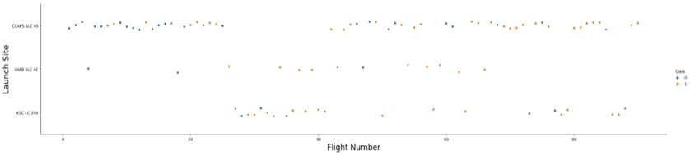

Flight Number vs. Launch Site
We can infer that the launch site CCAFS SLC 40 has launched the highest number of rockets compared to the other sites.
We can also find that the flights from launch sites VAFB SLC 4E and KSC LC 39A showed a higher success rate compared to the earlier flights.

Slide 19
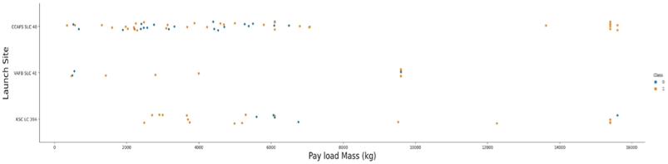
Payload vs. Launch Site
We observe that VAFB-SLC 4E launch site has no rockets launched for heavy payload mass greater than 10000kg.
We also observe that most of the rockets launched in all launch sites have a payload mass of less than 9000kg.
Compared to VAFB-SLC 4E and KSC LC 39A, CCAFS SLC 40 has a higher success rate for with heavier payloads of 14000 kg and 16000 kg.

Slide 20
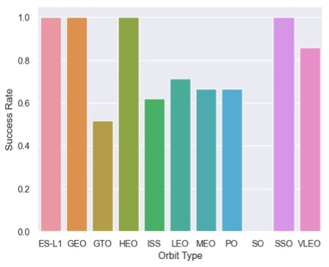
Success Rate vs. Orbit Type
From the figure, it is observed that orbits VLEO, ES-L1, GEO, HEO, and SSO have the highest success rates compared to the other orbit types
It is also observed that orbit SO has the least success rate

Slide 21
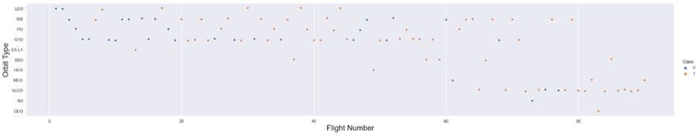
Flight Number vs. Orbit Type
From the figure we can observe that more rockets were launched in LES ISS PO GTO and VLEO
Scatter Plot Flight no v/s Orbit Type

Slide 22
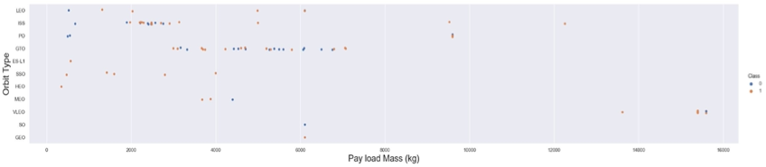
Payload vs. Orbit Type
There is a higher success for rockets with heavy payloads launched in PO, LEO, and ISS.
Rockets launched in SSO and MEO orbits on the other hand have a high success rate for lighter payloads.
Rockets launched in GTO have both positive landing rates and negative landing rates regardless of the size of the payload

Slide 23
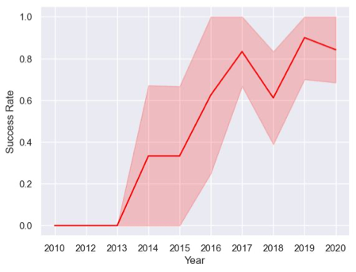
Launch Success Yearly Trend
We observe in that the success rate since 2013 kept increasing till 2020

Slide 24
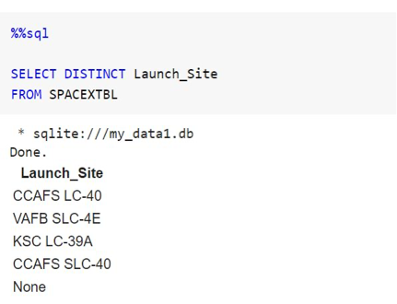
All Launch Site Names
An SQL table called SPACEXTBL using the existing data frame.
To find the Unique Launch Sites, the keyword DISTINCT was used on the column.

Slide 25
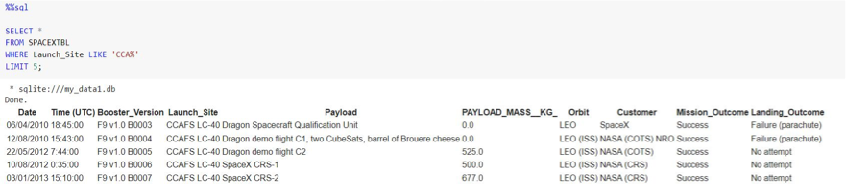
Launch Site Names Begin with 'CCA'
Keyword LIKE `CCA%` was used to get launch site names beginning with `CCA`.
LIMIT 5 keyword was used to display the first 5 records

Slide 26
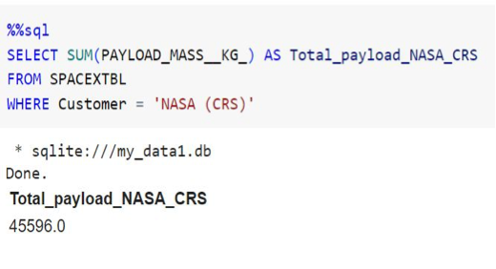
Total Payload Mass
SUM function was used to calculate the total payload mass of customers with the name ‘NASA (CRS)

Slide 27
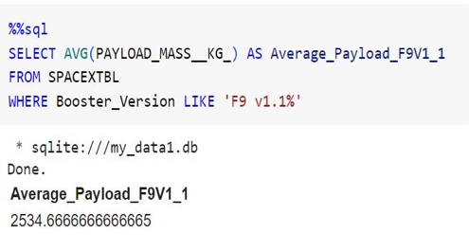
Average Payload Mass by F9 v1.1
The average payload mass carried by booster version F9 v1.1 was calculated using the AVG function

Slide 28
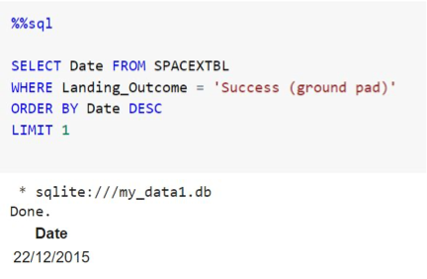
First Successful Ground Landing Date
SQL query was run for the first successful landing on ground pad.
The result shows that 22nd of December 2015 was the date for the first successful ground landing

Slide 29
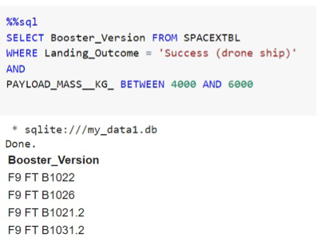
Successful Drone Ship Landing with Payload between 4000 and 6000
Using keywords BETWEEN and AND, the names of boosters that have successfully landed on drone ship and had payload mass greater than 4000kg but less than 6000kg were displayed.
The result shows 4 rockets.

Slide 30
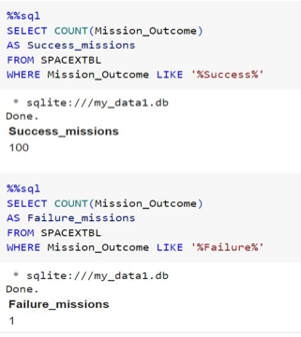
Total Number of Successful and Failure Mission Outcomes
The COUNT function was used to could the total number of successful missions and failed missions
The results show that there were 100 successful missions and 1 failed mission.

Slide 31
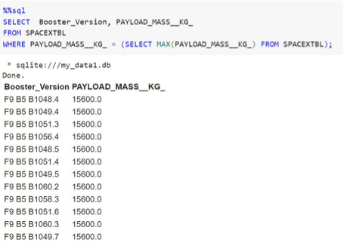
Boosters Carried Maximum Payload
A sub-query with the MAX function was used to retrieve the boosters that carried the maximum payload.
Results show that there are 12 in total

Slide 32
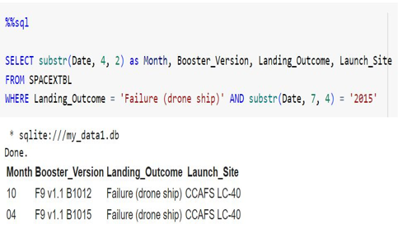
2015 Launch Records
Substr() was used to extract the month and year from the Date column.
The WHERE and AND keyword was used to get launch records of failed drone ship landings in 2015.
The result shows that the failed landings occurred in the months of April (04) and Octobe

Slide 33
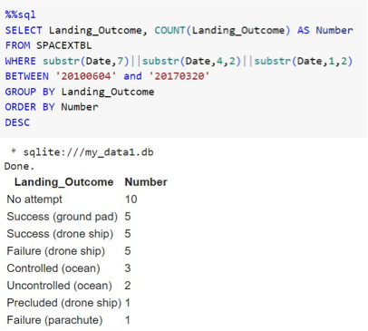
Rank Landing Outcomes Between 2010-06-04 and 2017-03-20
Keywords such as GROUP BY, ORDER BY, and DESC as well as functions like substr() and COUNT() were used to rank the count landing outcomes between 2010-06-04 and 2017-03-20, in descending order.
The results show that there are high numbers for no attempt (10), success on drone ship (5) as well as ground (5)

Slide 34

Section 3

Slide 35
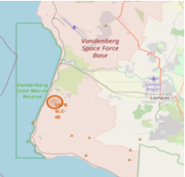
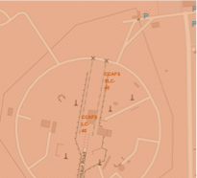
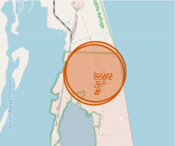
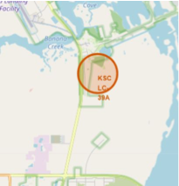
<Folium Map Screenshot 1>
• All launch sites as shown in the figure are located in coastal cities of the United States of America.

Slide 36
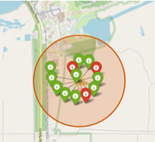
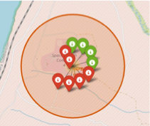
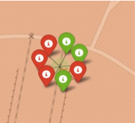
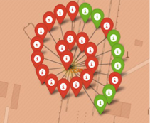
<Folium Map Screenshot 2>
The figure shows the launch outcomes for various launch sites;
Top left: VAFB SLC-4E •Top right: KSC LC-39A •Bottom left: CCAFS SLC-40
Bottom Right: CCAFS LC-4

Slide 37
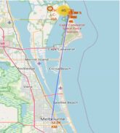
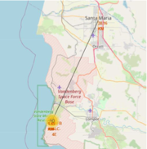
<Folium Map Screenshot 3>
From the figure we can show that launch sites are located very close to the coast i.e. 0.95km from CCAFS SLC 40 and 1.52km from VAFB SLC 4E
The same cannot be said for some railways and highways
We can also infer that launch sites are located far from major cities, i.e. VAFB SLC 4E is 38.16km away from its closest city Santa Maria and CCAFS SLC 40 is 56.04km away from Melbourne

Slide 38

Section 4

Slide 39
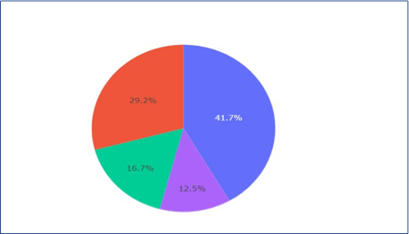
Pie Chart of Launch Sites v/s Success Rates
From Figure, it can be inferred that KSC LC-39A has the largest success rate with about 41.7% of the total success ratio with other sites.
Pie chart showing the Success rate of all Launch sites

Slide 40
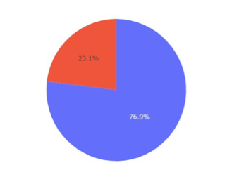
Pie Chart of Launch Sites with highest success ratio
It is also evident from Figure 25 that KSC LC-39A has the highest success ratio with about 76.9%, compared to the other sites;
• 73.1% for CCAFS LC-40 • 60% for VAFB SLC-4E • 57.1% for CCAFS SLC-40
Pie Chart showing the launch site with the highest success ratio

Slide 41
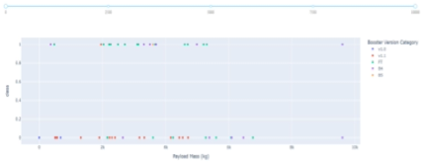
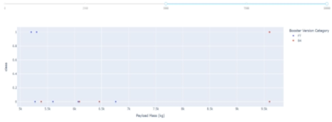
<Scatter Plot Payload vs Launch Outcome>
From the figures below, Booster version FT has the highest success rate with its payload mass of about between 700kg to 5,500kg.
It is also shown that rockets with payload mass above 5,500kg have a lower success rate, which means the heavier the payload, the slimmer the chance of a successful outcome.
Figure showing outcome booster versions with varying payload mass from launch sites
Figures showing outcome of booster versions
with payload mass greater than 5500 kg

Slide 42

Section 5

Slide 43
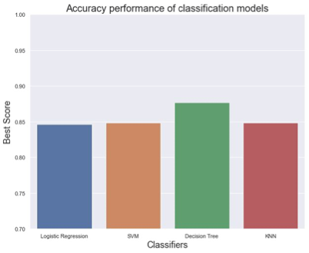
Classification Accuracy
From the bar chart in Figure 28, Decision tree classifier performed the best with an accuracy score of approximately 0.875 or ~ 87%

Slide 44
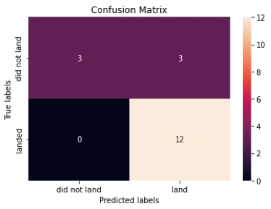
Confusion Matrix
After the dataset was spilt into training and test set, we ended up with only 18 test samples.
From the test set, the decision tree classifier was able to correctly predict for 12 observations that the rocket landed (12 True positives) and also 3 observations when the rocket did not landed (3 True Negatives).
The classifier also had 0 false negatives.
However, it had 3 false positives as it predicted wrongly for 3 observations that the that the rockets will land although they didn’t
Confusion matrix of decision tree

Slide 45
Conclusions
Orbit type should be considered because rockets launched to certain orbits (VLEO, ES-L1, GEO, HEO, and SSO) had higher success rates compared to others.
We can conclude that Launch sites are located in coastal cities for easy retrieval/recovery and are located far from busy areas like major highways and cities to minimize casualties in the event of a failure.
In recent years the no. of successful launches have increased.
Decision tree classifiers performed the best with approximately 87% making them a good model for landing outcome prediction

Slide 46
Appendix
Include any relevant assets like Python code snippets, SQL queries, charts, Notebook outputs, or data sets that you may have created during this project

Slide 47


